Slide 1
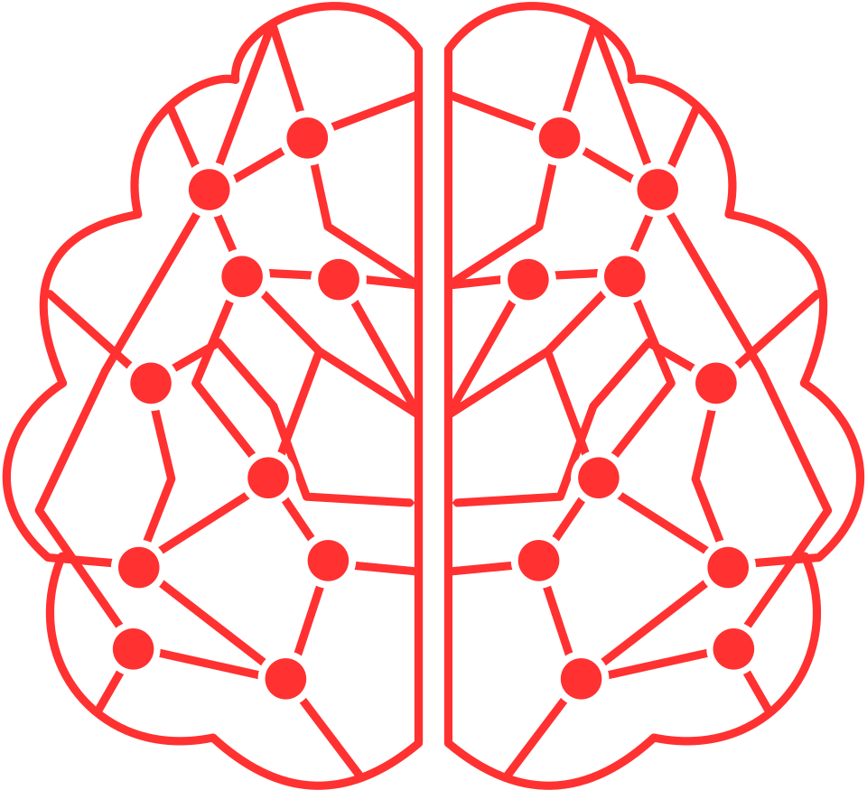

Artificial Intelligence: An introduction to the future
BENOUALI ABDELKADER ZAKARIA
University of Ain Temouchent

Slide 2

"
Welcome to the world of Artificial Intelligence, where science fiction and reality merge. Let's explore the remarkable impact of AI on our lives and our future
"
/
BENOUALI ABDELKADER
Introduction

Slide 3
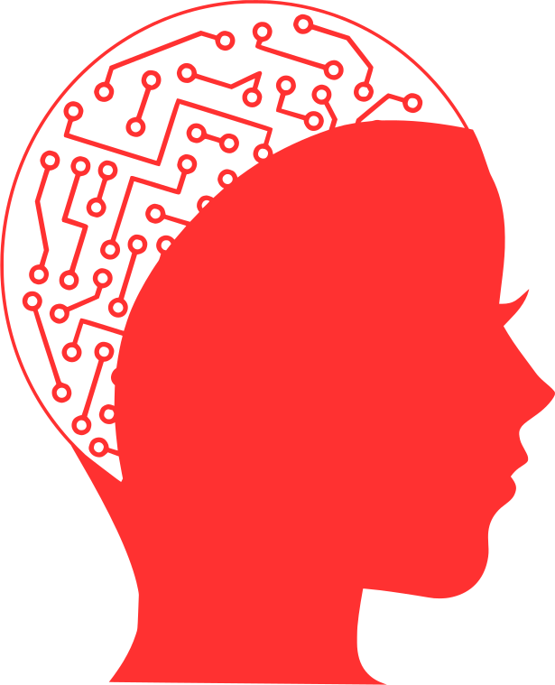
Artificial Intelligence (AI)?
Artificial Intelligence (AI) refers to the simulation of human intelligence in machines, allowing them to perform tasks that typically require human intelligence. This includes tasks such as understanding natural language, recognizing patterns, making decisions, and learning from experience. AI systems use algorithms and large datasets to analyze, process, and interpret information, allowing them to perform tasks with varying levels of complexity.
BENOUALI ABDELKADER
/
Artificial Intelligence (AI)?

Slide 4
HISTORY OF AI
KEY MILESTONES IN AI DEVELOPMENT

Slide 5

Can Machines Think?
Alan Turing explored the possibility of artificial intelligence in his paper "Computing Machinery and Intelligence" in 1950, which discussed building and testing intelligent machines. Science fiction also introduced the idea of artificially intelligent robots in the 20th century.
/
BENOUALI ABDELKADER
Can Machines Think?

Slide 6
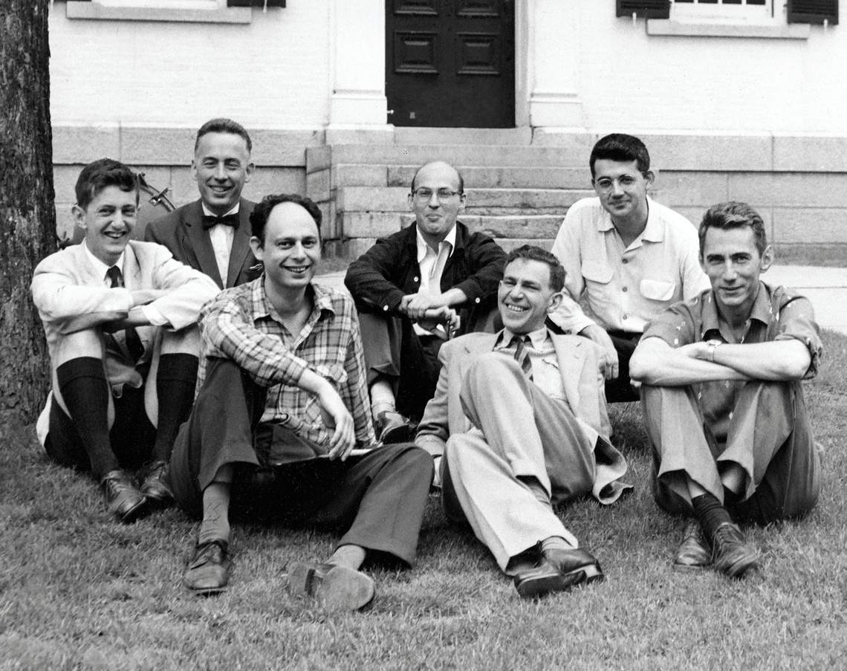
The Conference that Started it All
The Dartmouth Summer Research Project on Artificial Intelligence in 1956 witnessed the development of the first AI program, Logic Theorist, by Allen Newell, Cliff Shaw, and Herbert Simon. Although it did not meet McCarthy's expectations for standardizing AI research, it led to two
decades of AI research.
BENOUALI ABDELKADER
/
The Conference that Started it All

Slide 7
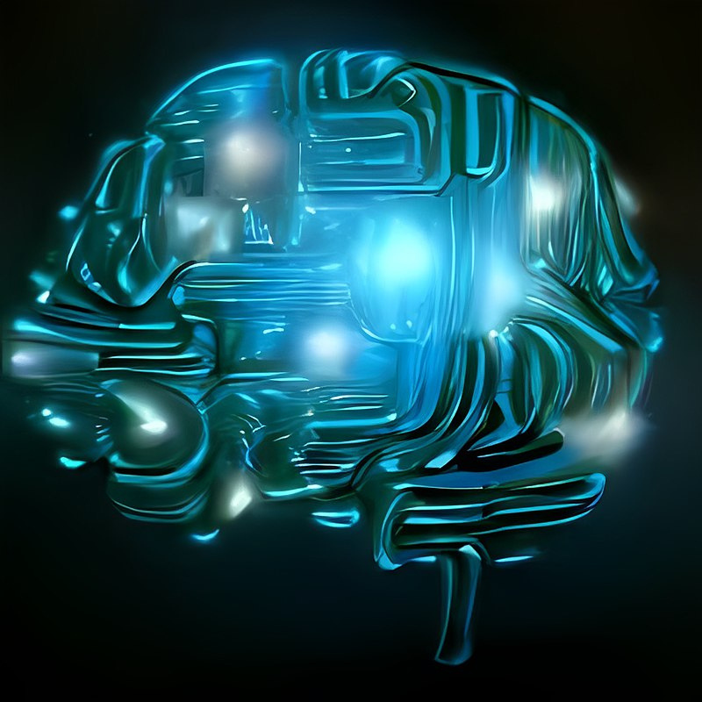
Ups and Downs of Achievements
From 1957 to 1974, AI technology made significant progress, with faster computers and better machine learning algorithms. Early successes such as the General Problem Solver and ELIZA showed AI's potential for problem-solving and language interpretation. The government funded AI research in institutions to develop a machine that could transcribe and translate spoken language and process data efficiently. However, achieving natural language processing, abstract thinking, and self-recognition remained a distant goal.
decades of AI research.
BENOUALI ABDELKADER
/
Ups and Downs of Achievements

Slide 8

Time Heals all Wounds
Moore's Law, which doubles computer memory and speed each year, has facilitated significant advancements in artificial intelligence (AI), including the victories of Deep Blue and Alpha Go over human champions. However, AI research is still dependent on computer storage limitations and the pace of Moore's Law.
BENOUALI ABDELKADER
/
Time Heals all Wounds

Slide 9
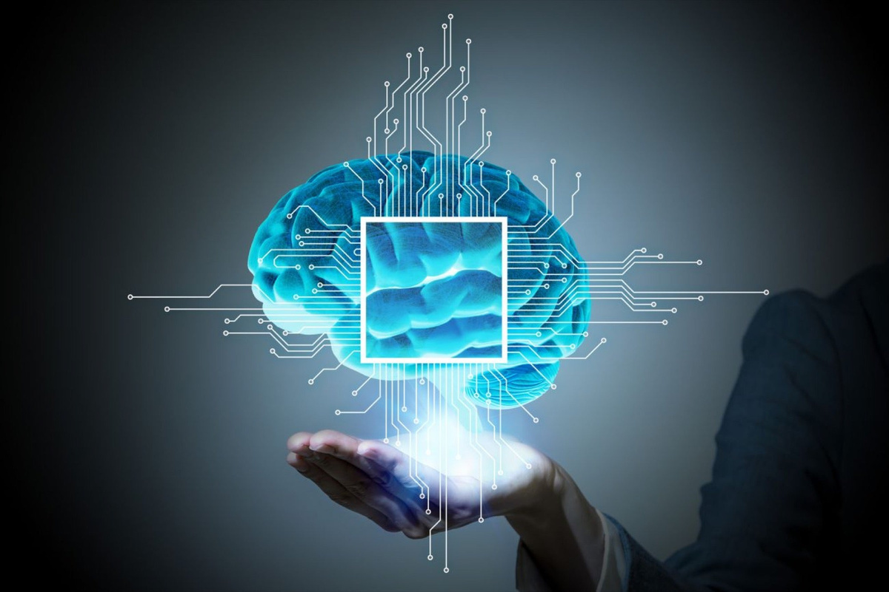
The Future
The rise of AI language and driverless cars presents ethical and policy questions as these technologies develop and potentially surpass human cognitive abilities. Despite the challenges, AI is expected to have a significant impact on society in the future
BENOUALI ABDELKADER
/
The Future

Slide 10
HOW TO LEARN AI
WE OFFER YOU A GROUP OF EXCELLENCE COURSES IN THIS FIELD

Slide 11
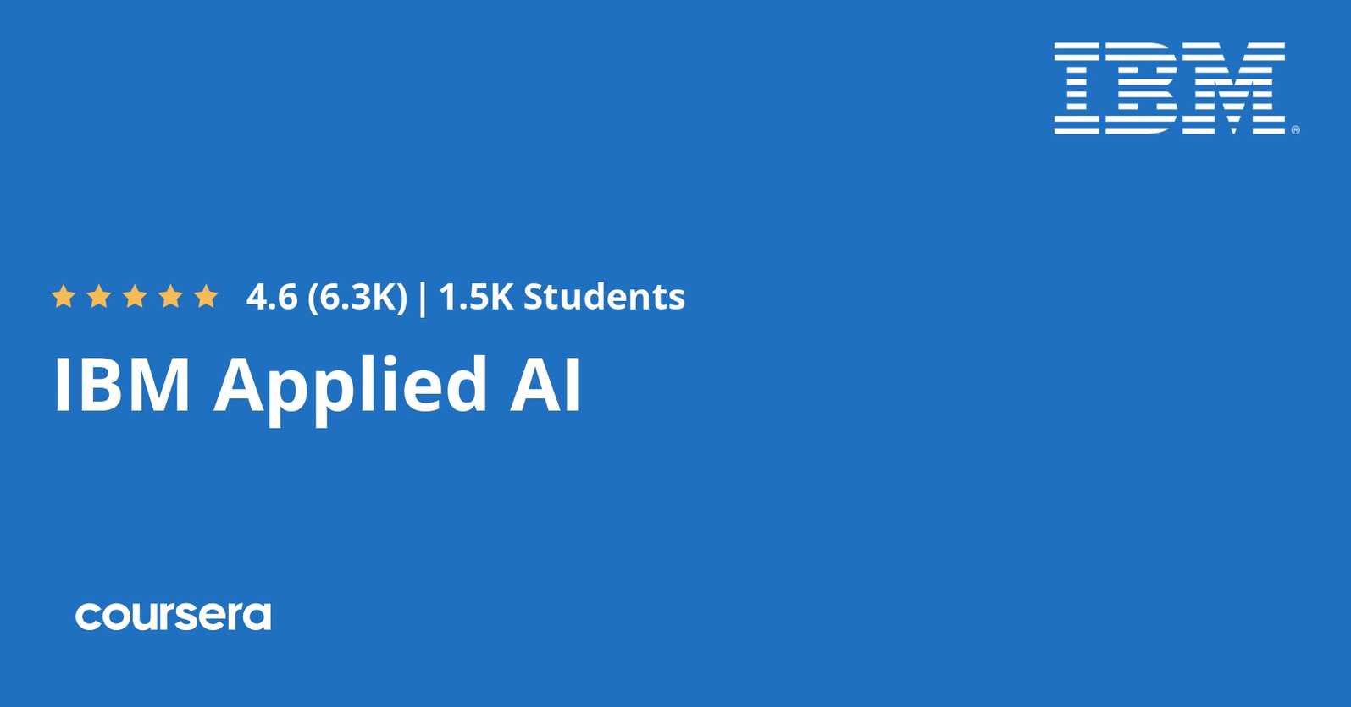
HOW TO LEARN AI
/
BENOUALI ABDELKADER
HOW TO LEARN AI

Slide 12
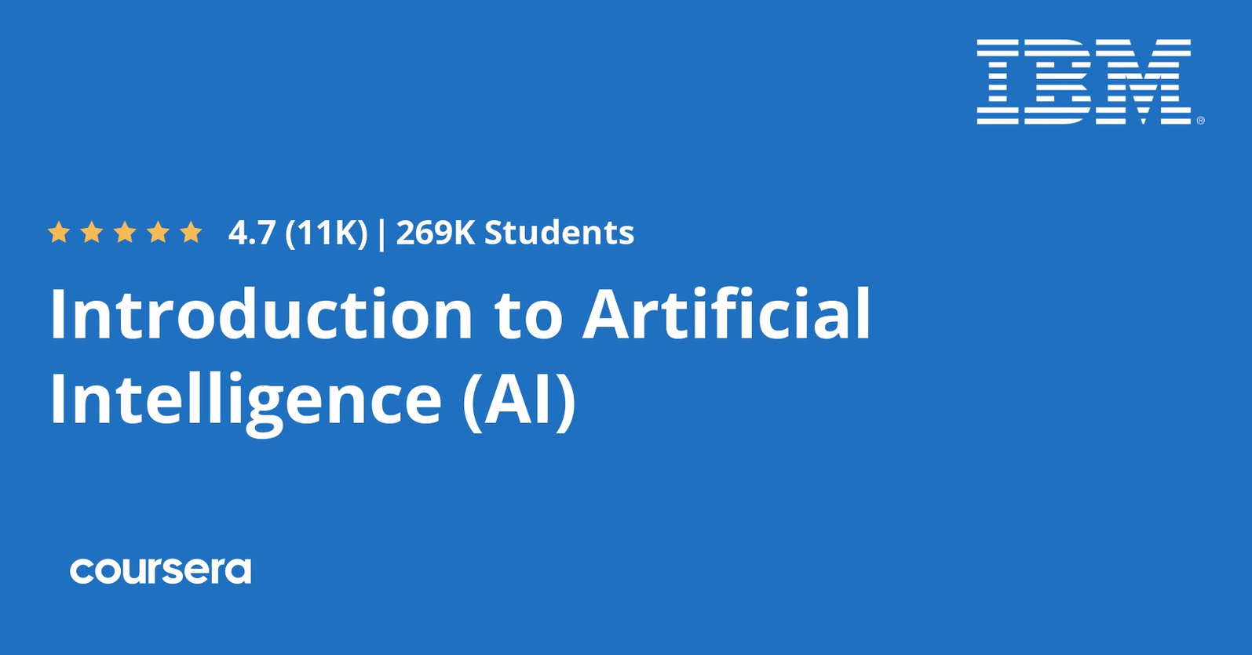
HOW TO LEARN AI
BENOUALI ABDELKADER
/
HOW TO LEARN AI

Slide 13
The Field of Artificial Intelligence (AI)

Slide 14

AI and Medicine
The use of AI in healthcare offers the potential to improve patient care, reduce medical errors, enhance research capabilities, and streamline administrative processes. However, it also comes with challenges related to data privacy, ethics, and the need for healthcare professionals to understand and trust AI systems. The healthcare industry is continually exploring innovative ways to leverage AI while addressing these challenges.
BENOUALI ABDELKADER
/
AI and Medicine

Slide 15
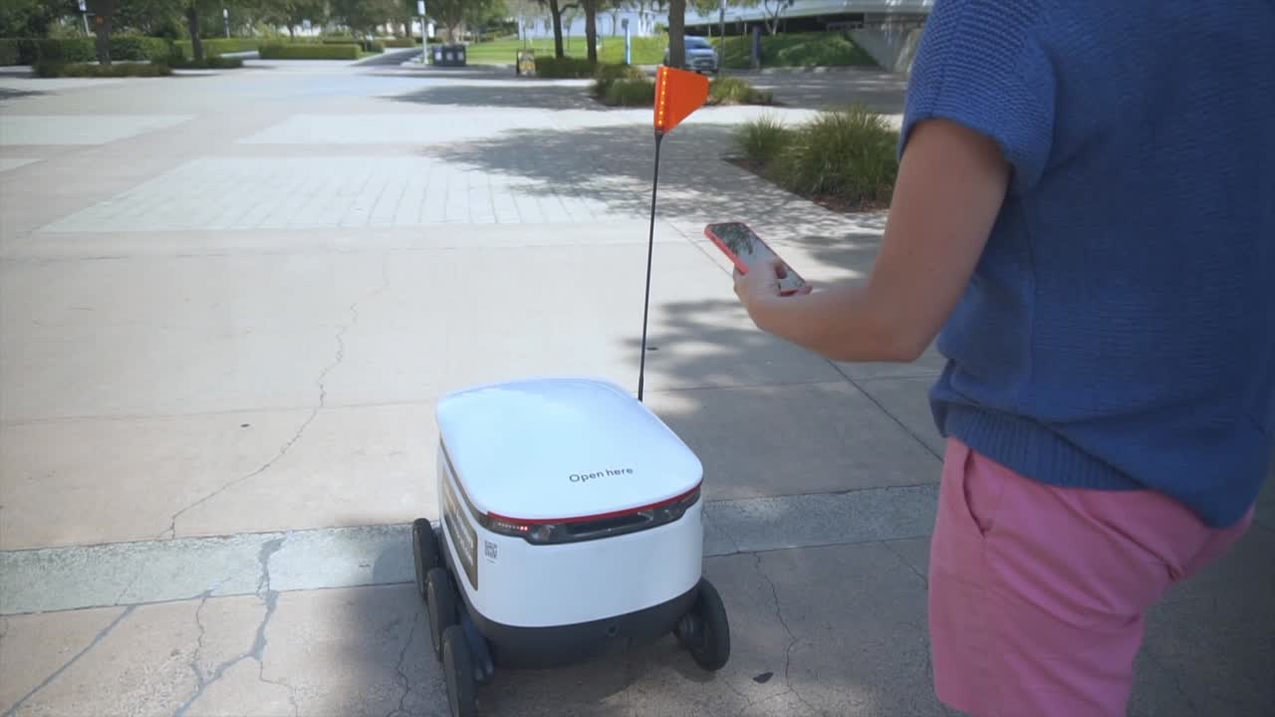
AI and transportation
AI's impact on transportation extends to improving passenger experience, reducing accidents, and enhancing environmental sustainability. It plays a significant role in shaping the future of smart, efficient, and safe transportation systems. However, it also presents challenges related to regulations, ethical considerations, and cybersecurity in this rapidly evolving industry
/
BENOUALI ABDELKADER
AI and transportation

Slide 16

AI and The war
The use of AI in warfare raises ethical, legal, and strategic concerns. It can impact issues related to accountability, transparency, and adherence to international laws and norms. There are ongoing debates and discussions about the responsible and ethical use of AI in military applications, and these conversations continue to evolve as technology advances.
BENOUALI ABDELKADER
/
AI and The war

Slide 17





Sources
A report based on several international sources known for their reliability and transparency in conveying information
/ Sources
benouali abdelkader

Slide 18
Conclusion
AI's advancement is crucial for our society's evolution, but responsibly addressing its challenges is equally important. Embracing AI's potential can shape an intelligent, innovative, and inclusive future. Let us continue to explore and engage in the ongoing conversation about this remarkable field
/Conclusion
benouali abdelkader

